Slide 1
A Study Of The Book Of Revelation
December 13, 2020

Slide 2
Revelation
I. Struggle on Earth (1-11)
A. John’s Vision (1)
B. Letters to 7 churches (2-3)
C. God in control (4-5)
D. Opening of seven seals (6-11)

Slide 3
Revelation 11
Interlude:
Outline-
2 Visions – 4 Pictures
Angel and 7 thunders (10:1-7)
Little book (10:8-11)
Measuring the temple (11:1-2)
Two witnesses (11:3-13)
Swift Retribution

Slide 4
Revelation 11
“Measuring The Temple, Two Witnesses,
And The Seventh Trumpet”
Outline –
Measuring the Temple (verses 1-2)
Two Witnesses (verses 3-14)
They will prophecy (verses 3-6)
They will be killed (verses 7-10)
They will be resurrected (verses 11-14)

Slide 5
Revelation 11
“Measuring The Temple, Two Witnesses,
And The Seventh Trumpet”
Outline –
Measuring the Temple (verses 1-2)
Two Witnesses (verses 3-14)
The Seventh Trumpet (verses 15-19)
Voice from heaven (verse 15)
Twenty-four elders worship God (verses 16-18)
Temple of God opened in heaven (verse 19)

Slide 6
Revelation 11
What Is The Point?
“Thus ends the interlude, a message of divine retribution. There is to be delay no longer. God’s message of judgment is to be proclaimed in all its bitterness. God’s people are known and protected by him. There will be a strong witness of the gospel during this period of distress just ahead. When it is all over, Christianity will have been thoroughly vindicated in the sight of men.”
– Ray Summer, Worthy is the Lamb, Page 166

Slide 7
Revelation 11
7 Seals
Victory (6:1-2)
War (6:3-4)
Famine (6:5-6)
Death (6:7-8)
Persecution (6:9-11)
Judgment (6:12-17)
Seven Trumpets (8:7-13;9:1-21; 11:14-ff)
1.
2.
3.
4.
Natural
Calamity
(8:7-13)
5. Internal rottenness (9:1-12)
6. External invasion (9:13-21)
INTERLUDE (10:1-11:13)
7. Victory of Saints (11:14-ff)

Slide 8
Revelation
Revelation 11
I. Struggle on Earth (1-11)
A. John’s Vision (1)
B. Letters to 7 churches (2-3)
C. God in control (4-5)
D. Opening of seven seals (6-11)
II. Christ And The Dragon In Conflict (12-22)
(Deeper Spiritual Meaning)
A. War (12-14)
B. Bowls of Wrath (15-16)
C. Fall of Babylon the Harlot (17-18)
D. Victory of God’s people (19-21)
E. Warnings about the Book (22)
1. Victory of God’s people
2. Judgment on the enemy (Rome)

Slide 9
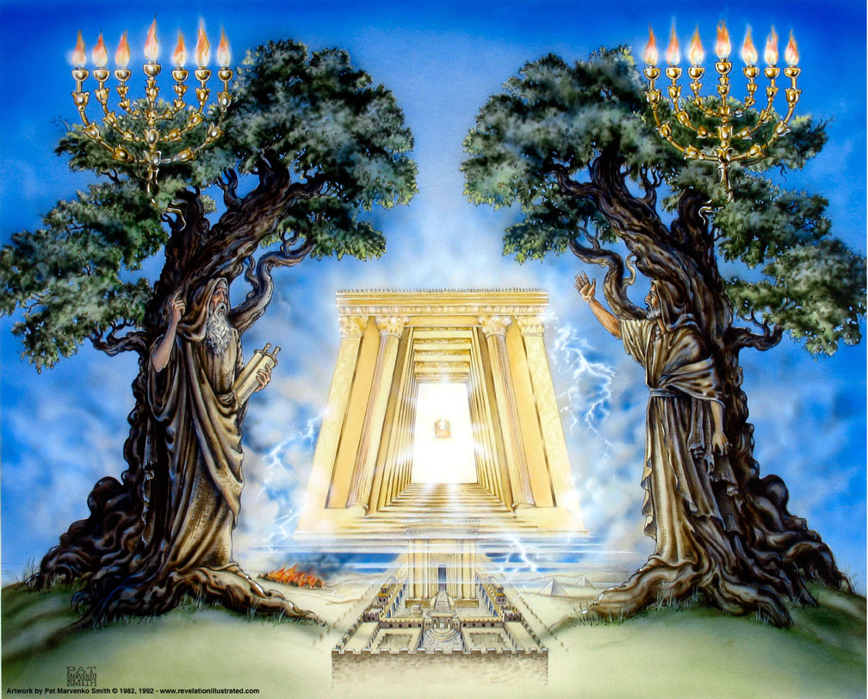
Book of Revelation: Chapter 11
The Measuring Rod and
the Two Witnesses

Slide 10

Revelation 11:1
Revelation 11
“And there was given me a reed like unto a rod: and one said, Rise, and measure the temple of God, and the altar, and them that worship therein.”

Slide 11
Measuring the Temple
Revelation 11
Picture # 3 – “measuring the temple”
A measuring rod like a (reed) staff
To measure the temple of God
The altar
Those who worship there
Given to John – probably God’s word
John’s last viewpoint on earth
Used for the separation, which results in either destruction or salvation

Slide 12
Measuring the Temple
Revelation 11
Picture # 3 – “measuring the temple”
Is this the OT temple?
Those who accept the “early date” suggest this proves that the temple was still standing … cf. Matthew 23:38, “Behold, your house is left unto you desolate.” Jesus had already “measured the temple” and found it desolate and fitted for destruction. Luke 21:24
The fact that John is on the island of Patmos and a literal temple (if still standing) would be in Jerusalem makes a literal measurement of the temple impossible.

Slide 13
Measuring the Temple
Revelation 11
Picture # 3 – “measuring the temple”
Is this the OT temple?
cf. Ezekiel measuring the temple and outer court. (Ezekiel 40-42)
Gave a picture of hope for the people of God. Separated the holy from the common (Ezekiel 42:20; 44:23)
cf. Zechariah measuring the unwalled city of Jerusalem. (Zechariah 2:2-5)
Gave a picture of protection and safety. Zechariah 2:5, “For I, saith Jehovah, will be unto her a wall of fire round about, and I will be the glory in the midst of her.”
Temple represents the church – which was being persecuted at the time of this revelation. Some suggest this is the 144,000 of Revelation 7.
The altar, the worship, and those who worship there.
1 Corinthians 3:16-17; Ephesians 2:21-22

Slide 14
Revelation 11:2
Revelation 11
“And the court which is without the temple leave without, and measure it not; for it hath been given unto the nations: and the holy city shall they tread under foot forty and two months.”

Slide 15
The Court Outside the Temple
Revelation 11
Picture # 3 – “measuring the temple”
The temple accepted; the court is rejected. Why?
A separation of that which is holy from that which is profane (read Ezekiel 40:1-42:20)
Church separated from the world
Saints are protected
The outside world AND those who profess to be His people, but are unfaithful, receive no protection!

Slide 16
The Court Outside the Temple
Revelation 11
Picture # 3 – “measuring the temple”
“For it has been given to the nations”
Will “tread underfoot” – who? Temple or the people?
Holy city represents the church – God’s people! The temple is gone, but the people remain!
“For 42 months …”(1,260 days – time, times, and half a time, equals 3½)
God will only allow this period of time – not complete, which means limiting the time.

Slide 17
The Court Outside the Temple
Revelation 11
Picture # 3 – “measuring the temple”
1,260 Days – Witness to prophesy (11:3). Woman fled into the wilderness (12:6)
42 months – Beast given power (13:5). Holy city trodden underfoot (11:2)
3½ years – Time, times, and half a time. Saints are persecuted (Daniel 7:25). Woman is nourished (12:14).
All these times show an incomplete, temporal period during which persecution will have to be endured! God will not permit it to continue indefinitely!

Slide 18
Revelation 11:3
Revelation 11
“And I will give unto my two witnesses, and they shall prophesy a thousand two hundred and threescore days, clothed in sackcloth.”

Slide 19
Revelation 11:4
Revelation 11
“These are the two olive trees and the two candlesticks, standing before the Lord of the earth.”

Slide 20
The Two Witnesses
Revelation 11
Picture # 4 – “my two witnesses”
Granted authority and empowered by God to “prophesy” (speak for God)
Proclamation of truth will continue even during the time of this intense persecution.
Also represented by “two olive trees” and “two lampstands”

Slide 21
The Two Witnesses
Revelation 11
Picture # 4 – “my two witnesses”
Prophesy for “1,260 days” – clothed in “sackcloth”
Sackcloth represents “mourning and a time of difficulty, humiliation, and affliction.”

Slide 22
The Two Witnesses
Revelation 11
Picture # 4 – “my two witnesses”
Who are the “two witnesses?”
They are “standing before the God of the earth.”
They are spokesmen for God. verse 5
They would prophecy. verses 3-6
They are enemies of “the beast.” verse 7
They would be killed. verses 7-10
They would be resurrected. verses 11-14; cf. Ezekiel 37

Slide 23
The Two Witnesses
Revelation 11
Picture # 4 – “my two witnesses”
Who are the “two witnesses?”
Some suggest two specific people (i.e. Moses and Elijah).
Others suggest the Old and New Testaments.
Two witnesses necessary to establish credibility. (Deuteronomy 17:6; 19:15; 1 Timothy 5:19)
Contextually, the “two witnesses” refer to the church, God’s people who would carry forth the gospel in the midst of persecution.
God calls them “my two witnesses” (verse 3).

Slide 24
The Two Witnesses
Revelation 11
Picture # 4 – “my two witnesses”
Who are the “two witnesses?”
Lampstands give light, and the olive trees provide oil for the lamps!
Candlesticks have represented the churches. (1:12; Chapters 2-3)
Olive trees (Zechariah 4:3-6)
The Lord will support their efforts and success in the mission! (Philippians 2:15)

Slide 25
Revelation 11:5
Revelation 11
“And if any man desireth to hurt them, fire proceedeth out of their mouth and devoureth their enemies; and if any man shall desire to hurt them, in this manner must he be killed.”

Slide 26
Revelation 11:6
Revelation 11
“These have the power to shut the heaven, that it rain not during the days of their prophecy: and they have power over the waters to turn them into blood, and to smite the earth with every plague, as often as they shall desire.”

Slide 27
The Ability of the Two Witnesses
Revelation 11
Picture # 4 – “my two witnesses”
“Fire” represents the gospel message they preach (Romans 1:16,17). Words would put the enemies to flight. (cf. Jeremiah 5:14; 23:29)
Fire purifies those who heed it (1 Peter 1:22)
Others will judge themselves unworthy (Acts 13:46)
All who reject will suffer God’s eternal vengeance. (2 Thessalonians 1:7-9)

Slide 28
The Ability of the Two Witnesses
Revelation 11
Picture # 4 – “my two witnesses”
The church’s work cannot be stopped until the mission is complete.
God’s power to protect the witnesses assures their success.
Isaiah 55:8-11
Allusions are drawn from faithful ancients of old:
Moses (Exodus 7:20)
Elijah (1 Kings 17:1-18:45)
Daniel’s three friends (Daniel 3:22)

Slide 29
Revelation 11:7
Revelation 11
“And when they shall have finished their testimony, the beast that cometh up out of the abyss shall make war with them, and overcome them, and kill them.”

Slide 30
Revelation 11:8
Revelation 11
“And their dead bodies (lie) in the street of the great city, which spiritually is called Sodom and Egypt, where also their Lord was crucified.”

Slide 31
The Work of the Two Witnesses
Revelation 11
Picture # 4 – “my two witnesses”
The church’s work cannot be stopped until the mission is complete.
The gospel extended to all the known world – (Colossians 1:6, 23)
Clear messages, confirmed with miracles, and the messages came from God!
Wait – did the “beast” win when he “killed them?” NO!

